Slide 1
Introducing the API for,
SOFTLAYER

Slide 2
What you’ll need:
A local (or virtual machine) running Linux/OS-X or Windows;
An Apache web server;
Apache configured for PHP;
Note: LAMP or WAMP implementations work great …
An IDE (I use NetBeans) but SublimeText or other text editor would suffice;
Jquery 2-1 minimized library (http://jquery.com/download/);
The SoftLayer API Client (http://sldn.softlayer.com/article/PHP);
Some Knowledge of Jquery, PHP, CSS & HTML

Slide 3
What we’ll be building:
PHP Scripts
HTML/CSS
SoftLayer API
Internet
getAccountInfo
getUserInfo
getHardwareInfo
makeMachine
HTTP Server
Local (or Virtual Machine)

Slide 4
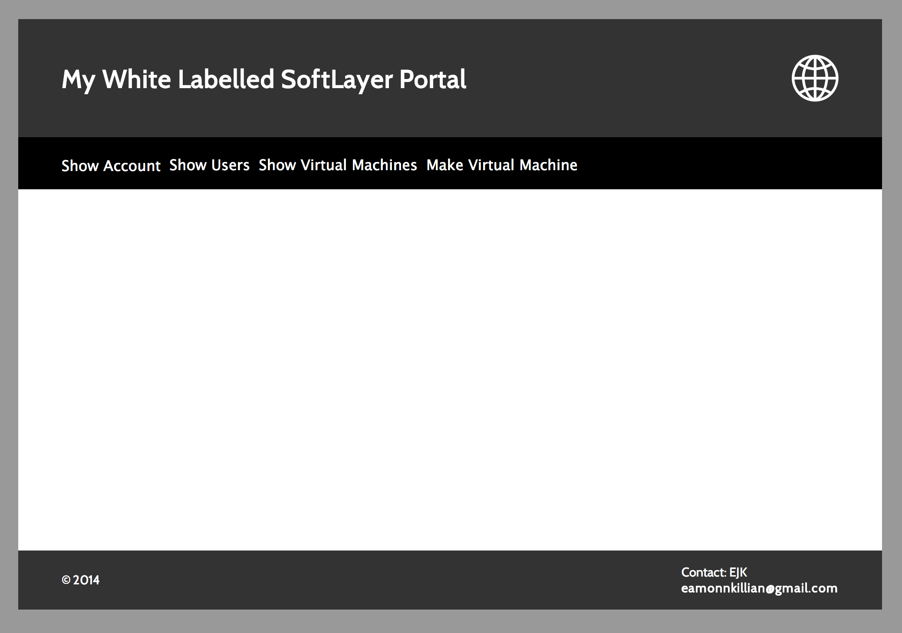
This is what it will look like:

Slide 5
Other great resources out there!
The simple programs used in this tutorial are based on the fabulous work
of “underscorephil” one of the SoftLayer API gurus. In addition though I'd
also highly recommend checking out these addresses for some great
reference/learning materials/scripts:
www.github.com/softlayer
www.github.com/SL-AshleyW/API-PHP-Scripts
www.github.com/shift31/hostbase-importer-softlayer
www.github.com/ycs334/softlayer-api-portal
www.github.com/yendor/softlayer
www.github.com/lboaretto/Stratos
www.github.com/tenthirtyone1031/coinzen
www.github.com/tylerflint/sandbox
... and many more!

